Slide 1
Analysing Amazon Sales data
Submitted By,
Sreedevi R

Slide 2
INTRODUCTION
Sales management has gained importance to meet increasing competition
- Brief overview of the increasing competition and the need for improved distribution methods
- Importance of sales management in commercial enterprises
- Goal: Optimize sales processes to reduce costs and increase profits

Slide 3
DETAILS OF DATA
Region
Country
Item Type
Sales Channel
Order Priority
Order Date
Order ID
Ship Date
Units Sold
Unit Price
Unit Cost
Unit Cost
Total Cost
Total Profit

Slide 4
Objectives of the Project
Briefly explain the project's objectives:
Extract, Transform, Load (ETL) an Amazon dataset
Analyse sales trends on a month-wise, year-wise, and yearly-month-wise basis
Identify key metrics and factors affecting sales
Explore meaningful relationships between attributes

Slide 5
ETL Process
Overview of Extract-Transform-Load (ETL) process
- Brief explanation of how ETL is applied to the Amazon dataset
- Python as the chosen programming language for ETL

Slide 6
Amazon Dataset Extraction
Description of the Amazon dataset used
- Source of the dataset and its structure
- Python libraries and tools used for data extraction

Slide 8
Data Transformation and Cleaning
Explanation of data transformation steps performed on the extracted dataset
Data cleaning techniques used to ensure data quality
Python libraries and functions utilized for data transformation and cleaning

Slide 9
Data Loading
Description of how the transformed data is loaded into a suitable data storage
The chosen data storage solution is a CSV file
Python libraries and functions used for data loading

Slide 10
Sales Trends Analysis
Introduction to the analysis of sales trends
For the analysis at month-wise, year-wise, and yearly-month-wise levels we are plotting graphs
Python libraries and techniques used for trend analysis

Slide 11
Key Metrics and Factors
Explanation of the identified key metrics affecting sales
Identification of factors influencing sales performance is the monthly and yearly details
Python libraries and methods used for metric analysis and factor identification

Slide 12
Meaningful Relationships
- Presentation of meaningful relationships between attributes and their impact on sales
- Data visualization (e.g., graphs, charts) illustrating relationships
- Python libraries used for visualization and analysis

Slide 13
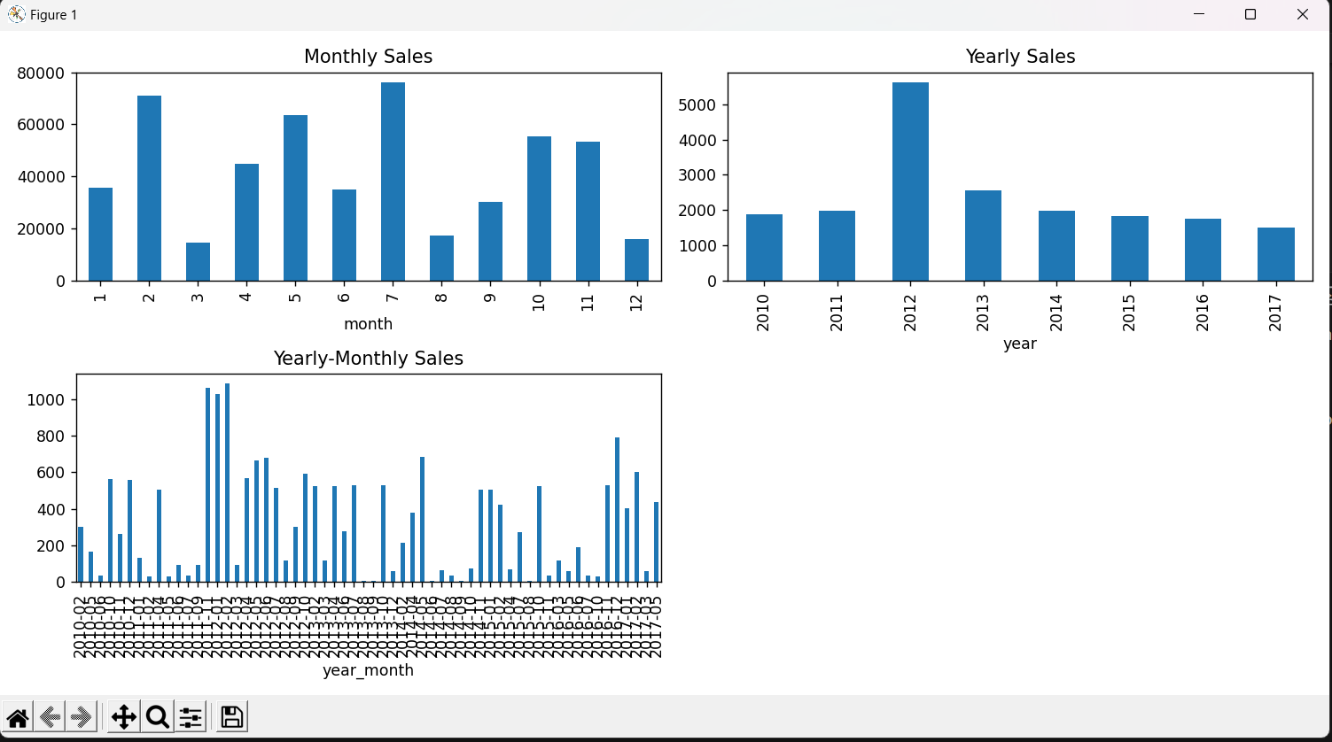

Slide 14
Thank You

